Slide 1

K
EXPLAINABLE E-COMMERCE DECISION INTELLIGENCE
Make the next product
decision explainable
A four-week pilot proposal for marketplace merchandising teams
TEAM YOUNGHTT
AREA 303 · TRACK 1 · TOPIC 05
Notes:
[Sources]
- D:/YOUNGHTT/README.md
- D:/YOUNGHTT/assets/branding/skunivo-logo-final-on-dark.png

Slide 2
OUR PROPOSAL
Approve a four-week Indonesia pilot of SKUNIVO
Use one weekly merchandising meeting to prove faster, more consistent and more accountable product triage.
THE DECISION
WHO USES IT
Turn 475 Indonesia listings into one auditable priority queue.
Category and merchandising managers
Promotion planners
83
10
4
Commercial analytics teams
active-review products
shops in pilot scope
platform categories
WHAT THEY RECEIVE
A ranked queue, recommendation, confidence, three reasons and a human decision log.
YOUNGHTT · TRACK 1 / TOPIC 05
SKUNIVO analysis · July 2026
02
Notes:
[Sources]
- D:/YOUNGHTT/outputs/product_recommendations.csv
- D:/YOUNGHTT/outputs/processed_latest_products.csv
- D:/YOUNGHTT/README_MVP.md

Slide 3
THE OPERATING PROBLEM
A weekly review cannot treat every listing as equally urgent
The user does not need another dashboard; they need a defensible order of action.
BEFORE SKUNIVO
DISCOUNT
PRICE
RATING
1,157
listings compete for attention
LIKES
SOLD-VALUE PROXY
Which hero SKU must be protected?
Which promotion deserves a test?
SHOP CREDIBILITY
Which deep discount should be reviewed?
YOUNGHTT · TRACK 1 / TOPIC 05
SKUNIVO analysis · July 2026
03
Notes:
[Sources]
- D:/YOUNGHTT/outputs/processed_latest_products.csv
- D:/YOUNGHTT/README_MVP.md

Slide 4
EVIDENCE BOUNDARY
The data supports prioritization—not forecasting
The proposal is deliberately limited to decisions the current evidence can support.
1,157
20
2
3
AVAILABLE
latest listings
shops
markets
snapshot dates
Price and displayed promotion
Ratings, volume and likes
Shop and category context
NOT AVAILABLE
Orders · Customers · Costs · Inventory history · Ad spend · Realized revenue · Treatment/control
Sold-value proxies
No demand forecast, causal promotion lift, profit optimization or ROAS claim.
YOUNGHTT · TRACK 1 / TOPIC 05
SKUNIVO analysis · July 2026
04
Notes:
[Sources]
- D:/YOUNGHTT/README.md
- D:/YOUNGHTT/README_MVP.md
- D:/YOUNGHTT/outputs/processed_latest_products.csv

Slide 5
PILOT MARKET CHOICE
Indonesia offers the clearest first decision opportunity
It contains 85% of the active-review queue and a materially deeper discount environment.
INDONESIA · PILOT NOW
VIETNAM · LEARN NEXT
83 / 98
53%
81
15 / 98
19%
active-review products
median displayed discount
discount reviews
active-review products
median displayed discount
Grouped shop validation produces a usable rank benchmark.
Broader category coverage makes it a valuable second phase.
The review problem is concentrated enough for a focused pilot.
Lower shop-held-out rank quality requires cautious model confidence.
YOUNGHTT · TRACK 1 / TOPIC 05
SKUNIVO analysis · July 2026
05
Notes:
[Sources]
- D:/YOUNGHTT/outputs/product_recommendations.csv
- D:/YOUNGHTT/outputs/processed_latest_products.csv
- D:/YOUNGHTT/outputs/model_metrics.csv

Slide 6
THE SOLUTION
SKUNIVO converts signals into a governed decision workflow
The AI proposes evidence; a merchant remains accountable for the action.
01
02
03
04
05
BENCHMARK
PRIORITIZE
EXPLAIN
DECIDE
LEARN
→
→
→
→
Country + category peers
Transparent 0–100 score
Three business reasons
Accept, override or defer
Capture outcome + feedback
BUSINESS OUTPUT
One review queue for hero protection, promotion testing and discount-efficiency decisions.
YOUNGHTT · TRACK 1 / TOPIC 05
SKUNIVO analysis · July 2026
06
Notes:
[Sources]
- D:/YOUNGHTT/README_MVP.md
- D:/YOUNGHTT/app.py
- D:/YOUNGHTT/app_components/decision_log.py

Slide 7
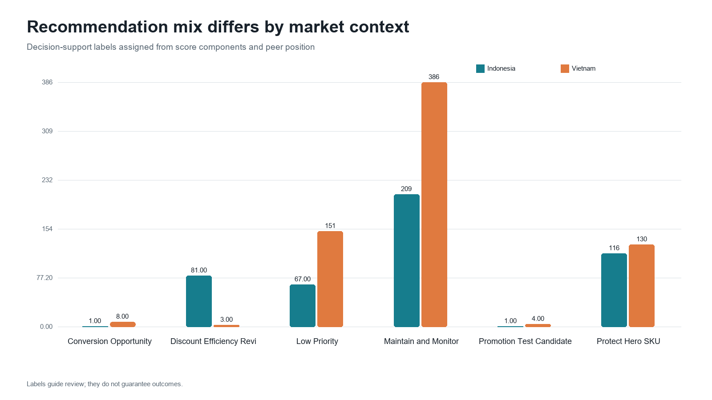
DECISION QUEUE
SKUNIVO concentrates active review on 8.5% of listings
The remaining portfolio stays visible but does not consume the same decision bandwidth.
98
products for active review
84
discount reviews
9
conversion opportunities
5
promotion test candidates
Recommendation labels guide review; they do not guarantee outcomes.
YOUNGHTT · TRACK 1 / TOPIC 05
SKUNIVO analysis · July 2026
07
Notes:
[Sources]
- D:/YOUNGHTT/outputs/product_recommendations.csv
- D:/YOUNGHTT/outputs/charts/02_recommendation_label_distribution.png

Slide 8
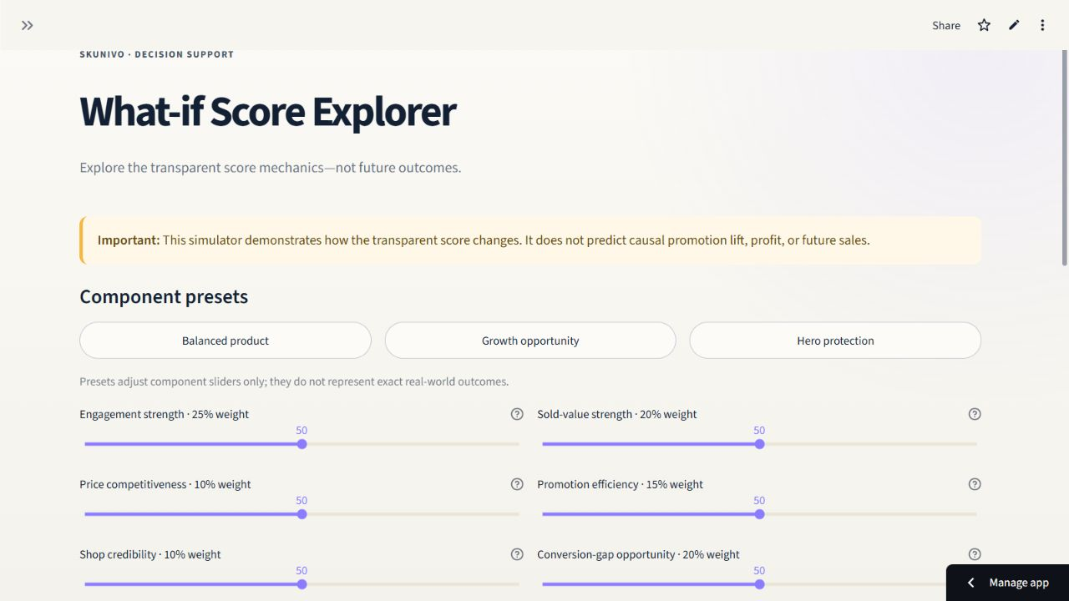
TRANSPARENT LOGIC
Every score can be reconstructed, challenged and reweighted
Six peer-relative components make the recommendation inspectable before any action is taken.
25%
Engagement strength
20%
Sold-value strength
10%
Price competitiveness
15%
Promotion efficiency
10%
Shop credibility
20%
Conversion-gap opportunity
YOUNGHTT · TRACK 1 / TOPIC 05
SKUNIVO analysis · July 2026
08
Notes:
[Sources]
- D:/YOUNGHTT/app_components/recommendation_ui.py
- D:/YOUNGHTT/.tmp_presentation/assets/app-whatif.png

Slide 9
DECISION EXAMPLE
A 54% discount becomes a review question
SKUNIVO does not recommend a deeper discount; it proposes a governed review of conflicting signals.
SKUNIVO PROPOSES
LAVOJOY OFFICIAL SHOP
Discount Efficiency Review
Let It Glow 10% Niacinamide Sunscreen Serum
INTERPRETATION
54%
49th
33rd
The current discount is deep, but peer-relative response is modest.
displayed discount
likes percentile
sold-value percentile
Do not deepen the discount before diagnosing content, availability and mechanism.
Opportunity score 37.70 · Medium confidence
HUMAN DECISION
Approve a controlled review or override with a documented reason.
YOUNGHTT · TRACK 1 / TOPIC 05
SKUNIVO analysis · July 2026
09
Notes:
[Sources]
- D:/YOUNGHTT/outputs/product_recommendations.csv — item_id 46658961924

Slide 10
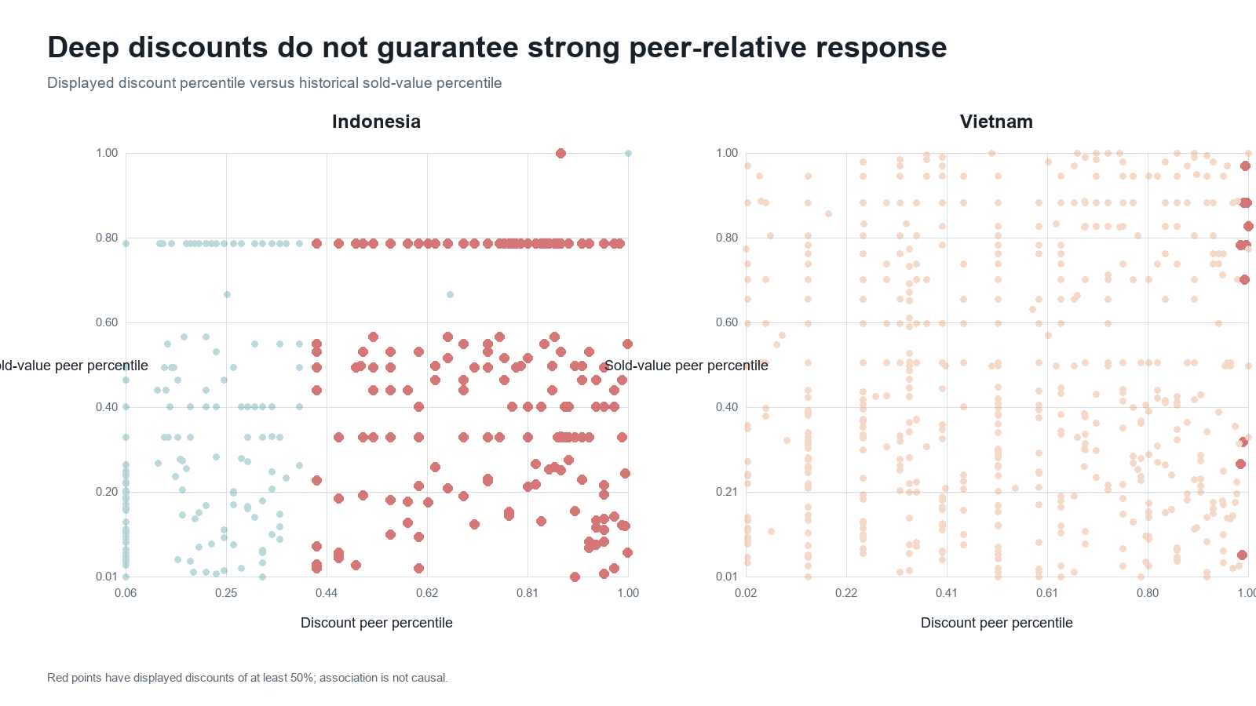
PROMOTION EVIDENCE
Deep discount does not guarantee strong peer-relative response
The pattern justifies a review queue; incrementality still requires an experiment.
84
discount-efficiency reviews
81 are in Indonesia.
Only five products qualify as promotion test candidates.
Causal lift is explicitly out of scope until treatment/control data exists.
YOUNGHTT · TRACK 1 / TOPIC 05
SKUNIVO analysis · July 2026
10
Notes:
[Sources]
- D:/YOUNGHTT/outputs/product_recommendations.csv
- D:/YOUNGHTT/outputs/charts/05_discount_vs_peer_response.png
- D:/YOUNGHTT/README_MVP.md

Slide 11
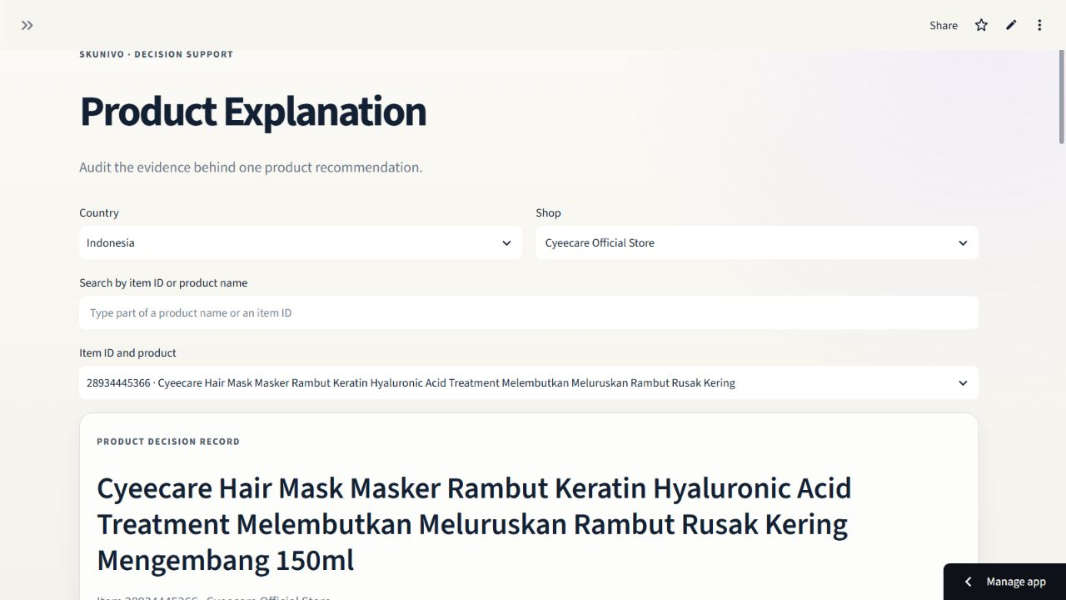
HUMAN ACCOUNTABILITY
AI proposes; merchants decide; overrides become learning data
The product explanation keeps evidence, confidence and business action in the same view.
ONE DECISION RECORD
Observed marketplace signals
Peer percentile benchmarks
AI contextual benchmark and confidence
Accept, override or defer with a reason
This is decision support—not automatic execution.
YOUNGHTT · TRACK 1 / TOPIC 05
SKUNIVO analysis · July 2026
11
Notes:
[Sources]
- D:/YOUNGHTT/.tmp_presentation/assets/app-explanation.png
- D:/YOUNGHTT/app_components/decision_log.py
- D:/YOUNGHTT/app_components/ai_benchmark.py

Slide 12
AI DESIGN
Two analytical tracks prevent the model from becoming the decision
The transparent score drives the queue; ML provides a contextual second opinion.
OBSERVED CONTEXT
TRACK A · RULE SCORE
DECISION LAYER
Transparent 0–100 score
Six auditable components
Price
Promotion
Ratings & likes
Shop credibility
Category context
Ranked queue
Recommendation label
Confidence
Three reasons
Human decision log
→
→
TRACK B · ML BENCHMARK
Estimate contextual sold-value proxy
Grouped validation by shop
YOUNGHTT · TRACK 1 / TOPIC 05
SKUNIVO analysis · July 2026
12
Notes:
[Sources]
- D:/YOUNGHTT/README_MVP.md
- D:/YOUNGHTT/outputs/model_metrics.csv
- D:/YOUNGHTT/app_components/ai_benchmark.py

Slide 13
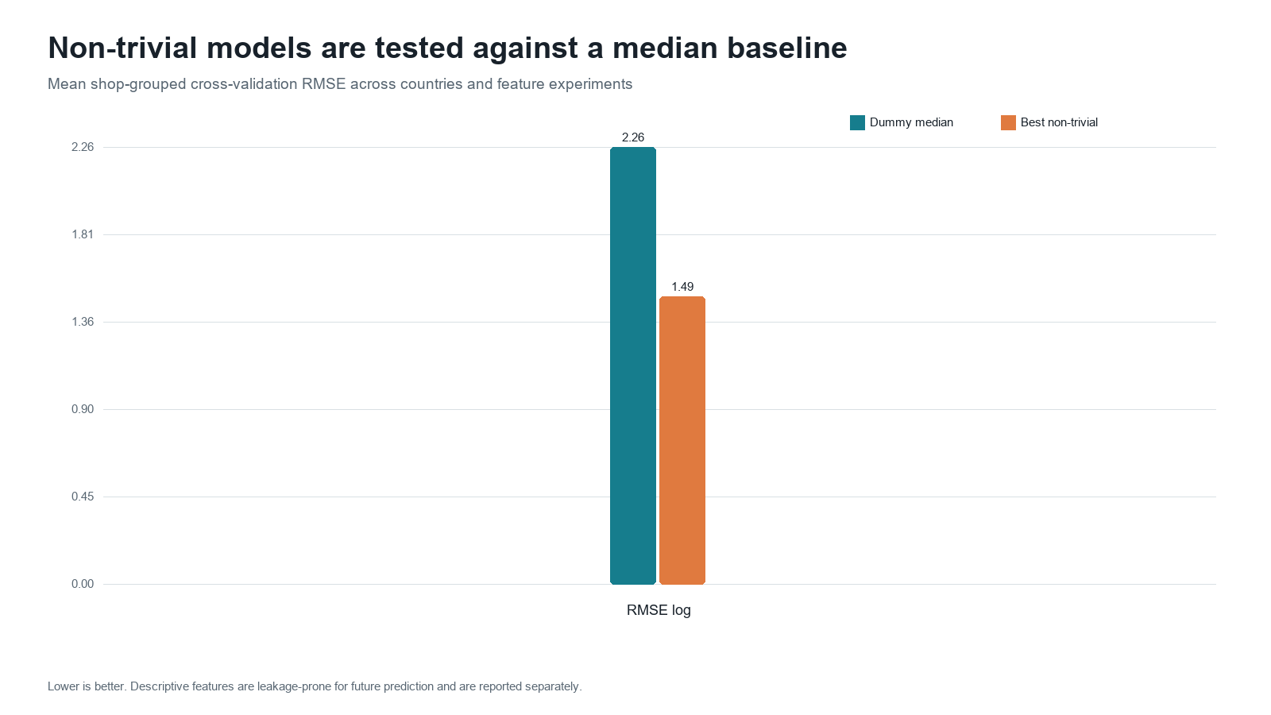
VALIDATION EVIDENCE
Model performance supports Indonesia-first deployment
All validation is grouped by shop; Vietnam remains visible with lower model confidence.
0.77
Indonesia Spearman
0.35
Vietnam Spearman
Deployment rule
Use the model as a benchmark in Indonesia; reduce confidence and keep rule-based explanations primary in Vietnam.
YOUNGHTT · TRACK 1 / TOPIC 05
SKUNIVO analysis · July 2026
13
Notes:
[Sources]
- D:/YOUNGHTT/outputs/model_metrics.csv
- D:/YOUNGHTT/outputs/charts/07_model_baseline_comparison.png

Slide 14
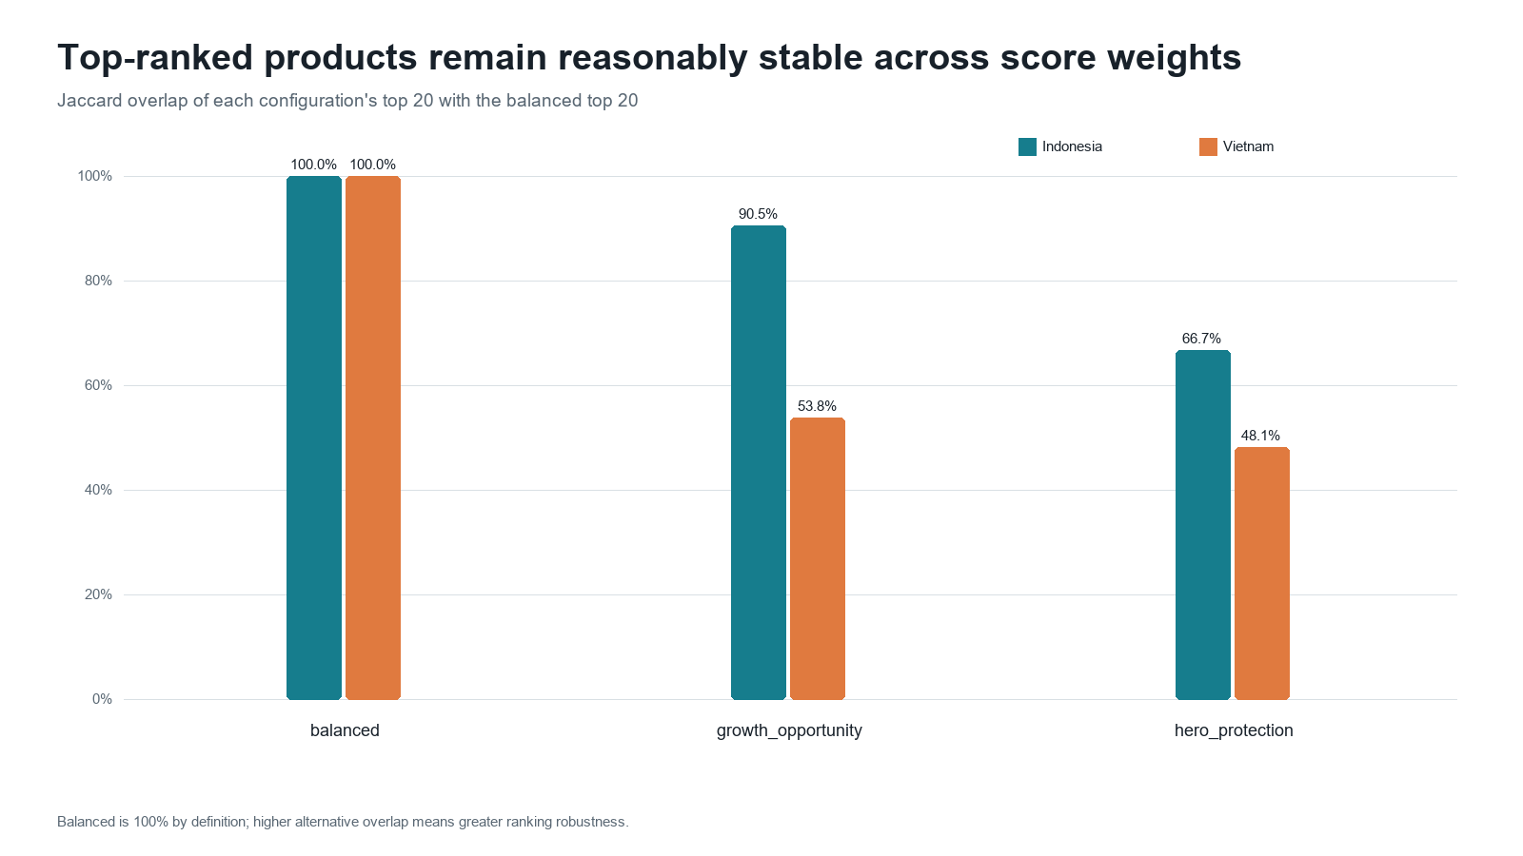
ROBUSTNESS
The ranking remains stable under strategic reweighting
Changing reasonable weights preserves overall order while adapting the top queue.
>0.986
rank correlation vs. balanced
90%
Indonesia top-20 overlap
under growth weighting
Governance implication
Business owners may choose a preset, but every weight change remains visible and testable.
YOUNGHTT · TRACK 1 / TOPIC 05
SKUNIVO analysis · July 2026
14
Notes:
[Sources]
- D:/YOUNGHTT/outputs/score_sensitivity.csv
- D:/YOUNGHTT/outputs/charts/08_score_weight_sensitivity.png

Slide 15
BUSINESS VALUE
Operational discipline before revenue promises
The pilot measures whether better prioritization changes how decisions are made.
FASTER
MORE CONSISTENT
MORE ACCOUNTABLE
Reduce time spent scanning low-priority listings.
Apply the same peer logic across shops and categories.
Record the evidence, owner and reason behind each decision.
PILOT MEASURES
Time-to-triage versus week-one baseline
Explanation usefulness and user trust
Recommendation accept / override / defer rate
Number of testable hypotheses created
Financial impact becomes measurable after transaction, cost and experimental data are connected.
YOUNGHTT · TRACK 1 / TOPIC 05
SKUNIVO analysis · July 2026
15
Notes:
[Sources]
- D:/YOUNGHTT/README_MVP.md
- D:/YOUNGHTT/app_components/decision_log.py
- D:/YOUNGHTT/app_components/feedback.py

Slide 16
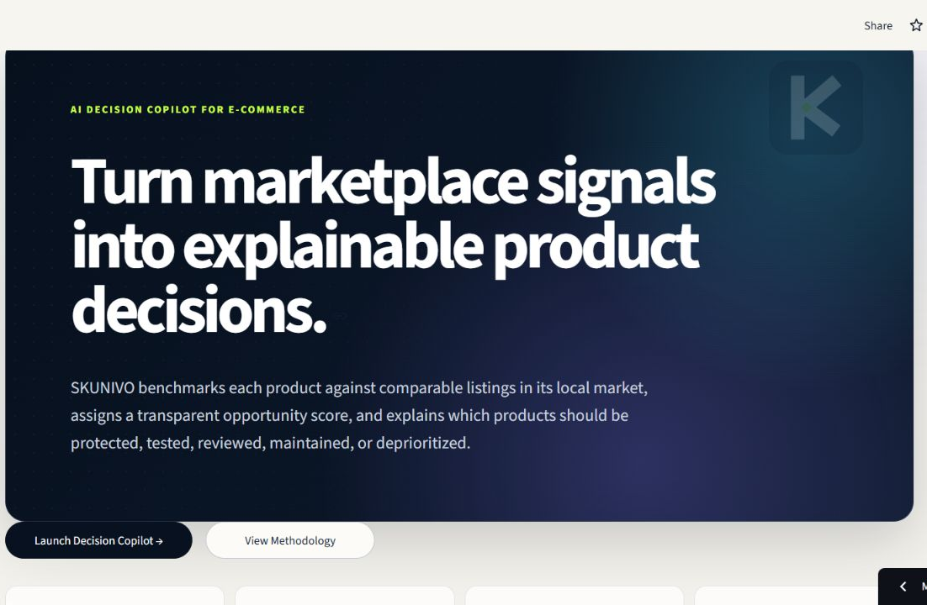
FEASIBILITY
The MVP is live today and the architecture can scale in layers
The pilot uses precomputed outputs; future phases can connect APIs and outcome data without redesigning the decision workflow.
LIVE NOW
Public Streamlit application
English and Vietnamese interface
Decision Log + Google Sheet feedback
SCALE NEXT
Scheduled marketplace ingestion
Warehouse/API integration and access control
Outcome monitoring and model governance
YOUNGHTT · TRACK 1 / TOPIC 05
SKUNIVO analysis · July 2026
16
Notes:
[Sources]
- D:/YOUNGHTT/.tmp_presentation/assets/app-home.png
- https://skunivo.streamlit.app/
- D:/YOUNGHTT/README_MVP.md
- D:/YOUNGHTT/deployment/google_apps_script.gs

Slide 17
PILOT PLAN
Four weeks are enough to validate adoption, efficiency and trust
Each stage ends with evidence; automation only expands after the team passes the gate.
WEEK 1
WEEK 2
WEEK 3
WEEK 4
Calibrate
Triage
Decide
Evaluate
Agree weights, labels and baseline time
Use SKUNIVO in the weekly review
Accept, override or define tests
Compare workflow metrics and feedback
PROPOSED SUCCESS GATES
≥70% decisions logged · ≥25% lower median triage time · ≥4/5 explanation usefulness · zero critical data-quality failures
Targets are pilot criteria—not observed results—and should be confirmed with the operating team.
YOUNGHTT · TRACK 1 / TOPIC 05
SKUNIVO analysis · July 2026
17
Notes:
[Sources]
- D:/YOUNGHTT/README_MVP.md
- D:/YOUNGHTT/app_components/decision_log.py
- D:/YOUNGHTT/app_components/feedback.py
- Proposed success thresholds are Team YOUNGHTT pilot design assumptions

Slide 18
THE DECISION WE ASK FOR
PILOT
Approve one market.
One team. Four weeks.
Explainable prioritization
NEXT
Add transactions + test flags
for lift measurement
SCALE
Add costs + inventory
for profit and stock decisions
SKUNIVO should grow only when the evidence grows.
This prototype prioritizes products using observed marketplace signals. It does not estimate causal promotion lift or forecast transactional demand with the current three-day snapshot dataset.
YOUNGHTT · TRACK 1 / TOPIC 05
skunivo.streamlit.app
18
Notes:
[Sources]
- D:/YOUNGHTT/README.md
- D:/YOUNGHTT/README_MVP.md
- https://skunivo.streamlit.app/

